Slide 1
Course Name : Data Structures & Algorithms
Dr. S. Nandagopalan
Computer Science & Information Systems

Slide 2
Graphs, DFS, BFS
Session 11

Slide 3
Agenda
Graphs –
Properties, Representation, etc.
DFS
BFS
Summary

Slide 4
Graphs
The paper written by Leonhard Euler on the Seven Bridges of Königsberg and published in 1736 is regarded as the first paper in the history of graph theory
A Graph, G is defined as a set of vertices and edges G = {V, E}, where V represents the vertices and E represents the edges
(a) Undirected Graph (b) Directed Graph
1
2
1
2
5
3
4
4
3

Slide 5
Applications
Electrical engineering
Electrical Network
Telecommunication Engineering
TV, Mobile, Broadband, etc.
Computer engineering
Computer Networks (LAN, MAN, WAN,..)
Road map
Coloring the map
Finding the shortest path

Slide 6
Definitions
Directed
A graph in which every edge is directed is called as a directed graph or a digraph
Undirected graphs
A graph in which every edge is undirected is called as an undirected graph or simply a graph.
Indegree
In a directed graph, the number of edges which have v as their terminal vertex
Outdegree
For any vertex v the number of edges which have v as their initial vertex

Slide 7
Connected Graph
An undirected graph is called connected if for every pair of vertices there exists a path between them
If a graph is not connected then we refer to its connected sub-graphs separately
(a) Connected (b) Disconnected
1
2
1
2
3
4
3
4
6
5
5

Slide 8
Strongly Connected Graphs
For every pair of vertices (i, j) there exists a path from i to j and a path from j to i, then we say that the graph is strongly connected.
(a) Strongly connected (b) Disconnected
1
2
1
2
3
4
3
4
5
5

Slide 9
Weighted graphs
If every edge in a graph is assigned a value or weight or cost that may represent the travelling cost from, say vertex i to vertex j.
8
9
1
2
1
2
4
20
4
6
8
8
4
4
3
3
4
1

Slide 10
Graph Representations
Adjacency Matrix
The Adjacency Matrix is a square matrix with n rows and n columns.
Each entry in the matrix represents 1, if there exists an edge <i, j> between vertex i and vertex j and 0 when there is no edge.
Therefore, the adjacency matrix is a Boolean matrix for both undirected and directed graphs
For an undirected graph G,
Adjacency Matrix = A(i, j) = 1 if (i, j) ∈ E or (j, i) ∈ E
0 otherwise
Similarly, for a digraph G,
Adjacency Matrix = A(i, j) = 1 if (i, j) ∈ E
0 otherwise

Slide 11
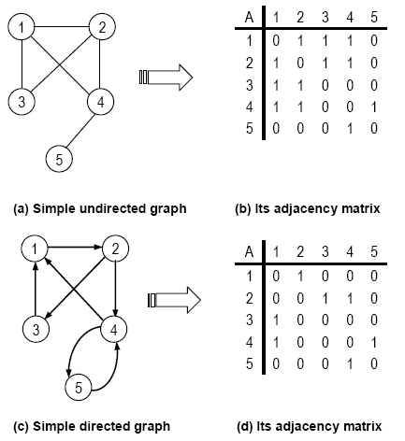
Example

Slide 12
Inferences
The adjacency matrix for an undirected graph is symmetric
The memory requirements for an undirected or directed graph is always Θ(n²) or n * n, where n is the number of vertices
Instead of storing the adjacency matrix as a two dimensional integer array (each int requires 2 bytes), we can use bits to store these entries
The time-complexity of adjacency matrix representation is therefore O(n²)

Slide 13
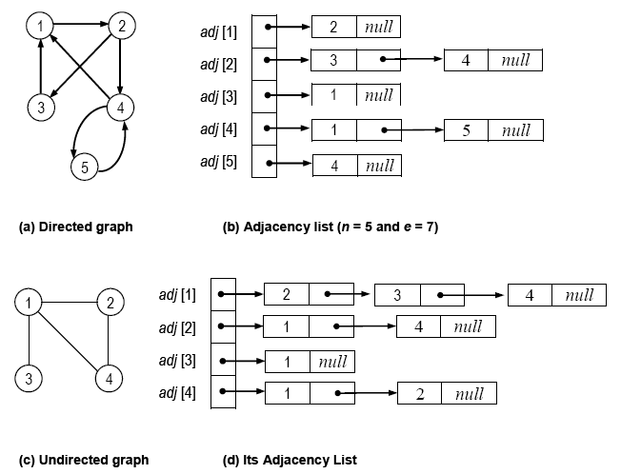
Adjacency List
In the adjacency list representation, the adjacency information is stored in the form of a singly linked list.
For each vertex in the graph, a linked list is created to store all the adjacent vertices

Slide 14
Inferences
The adjacency list representation obviously has a better memory usage than adjacency matrix.
The memory required for an undirected graph is n + 2*e.
In an undirected graph, every pair of vertices (i to j and j to i) must be stored in the adjacency list. Hence, the storage requirement is 2*e.
The memory required for a digraph is n + e.
In a diagraph each edge information is to be stored uniquely, as both i to j and j to i need not be stored (unless there are two separate edges).
The time-complexity to determine the number of vertices in an adjacency list representation is Θ(n).

Slide 15
Depth First Search (DFS)
Graph Traversal Technique
Uses stack as its main data structure
It is an appropriate example for decrease-by-one technique. Here, n is the number of vertices in a given graph, G.
The main applications of Depth-First Search are
Checking the connectivity of a graph
Finding whether a graph has cycles or not
Finding the connected components of a graph
Finding articulation points of a graph

Slide 16
Example
start
start
start
1
1
1
2
3
2
3
2
3
4
5
6
7
4
5
6
7
4
5
6
7
8
8
8
start
start
start
1
1
1
2
3
2
3
2
3
4
5
6
7
4
5
6
7
4
5
6
7
8
8
8

Slide 17
Example...
start
start
start
1
1
1
Final DFS tree
2
3
2
3
2
3
4
5
6
7
4
5
6
7
4
5
6
7
8
8
8
start
1
2
3
4
5
6
7
8

Slide 18
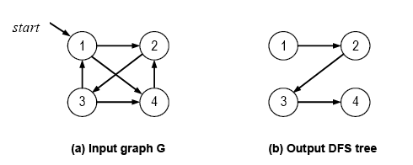
Example-2: Strongly Connected, Directed Graph

Slide 19
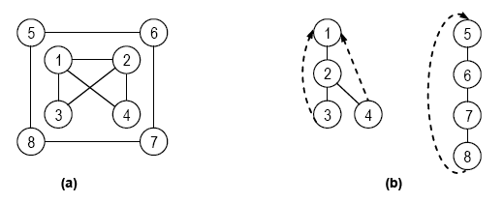
Example-3: Undirected, Disconnected Graph
tree edge: Whenever a new unvisited vertex is reached for the first time, it is attached as a child to the vertex from where it is being emerged.
back edge: This is an edge leading to a previously visited vertex other than its immediate predecessor (since it connects a vertex to its ancestor, other than the parent in the DFS forest) .

Slide 20
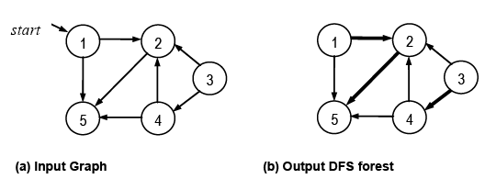
Example-4: Directed, Weakly connected Graph

Slide 21
Algorithm (Connected Graph)
■ Algorithm dfs(G, v)
// Input: A Graph, G and starting vertex v
// Output: DFS tree
visited[v] ← 1 // mark v as visited
for each vertex w adjacent to v do
if visited[w] = 0 // vertex not yet visited
dfs(G, w) // continue to explore
end dfs.

Slide 22
Algorithm (DisConnected Graph)
■ Algorithm DFS_Visit_All(G)
// Input: G{V, E}
// Output: DFS spanning tree or forest
for each vertex v ∈ V do
visited[v] ← 0 // mark all vertices as unvisited
for each vertex v ∈ V do
if visited[v] = 0
dfs(G, v)
end DFS_Visit_All.

Slide 23
Path Finding
We can specialize the DFS algorithm to find a path between two given vertices u and z using the template method pattern
We call DFS(G, u) with u as the start vertex
We use a stack S to keep track of the path between the start vertex and the current vertex
As soon as destination vertex z is encountered, we return the path as the contents of the stack

Slide 24
Cycle Finding
We can specialize the DFS algorithm to find a simple cycle using the template method pattern
We use a stack S to keep track of the path between the start vertex and the current vertex
As soon as a back edge (v, w) is encountered, we return the cycle as the portion of the stack from the top to vertex w

Slide 25
Breadth-First Search (BFS)
The Breadth-First Search (BFS) is somewhat similar to Depth-First Search except that all the adjacent vertices are visited from a starting vertex, instead of exploring the vertices in depth-first manner
Queue is the main data structure used for BFS, instead of stack as in DFS
This method also finds the/visits the vertices in a systematic manner

Slide 26
Example-1: Undirected, Connected Graph
1
1
1
2
3
2
3
2
3
4
5
6
7
4
5
6
7
4
5
6
7
8
8
8
1
1
1
2
3
2
3
2
3
4
5
6
7
4
5
6
7
4
5
6
7
8
8
8

Slide 27
Example-2: Directed, Weakly Connected Graph
Final BFS Tree
1
2
1
2
3
3
5
4
5
4
1
2
3
5
4

Slide 28
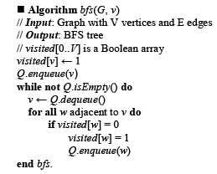
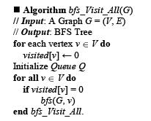
BFS Algorithm

Slide 29
Exercises
For a given graph, G write an algorithm based on DFS/BFS whether it is connected or not?
Find the spanning tree of a connected undirected graph, G using DFS/BFS. Write the complete algorithm.
Assume that you are given a connected undirected graph, G design an algorithm to return ‘true’ if it has cycles, ‘false’ otherwise by using a modified DFS algorithm.
For any graph, G find a path from given source vertex, s to a destination vertex, v where s ≠ v. Write a modified DFS/BFS algorithm to achieve this. Print ‘path not found’ if you can’t find a path.

Slide 30
Algorithm for Cycle Finding
void DFS_Cycle(int v) {
visited[v] = true;
list <int> :: iterator adj_node;
for(adj_node = adjlist[v].begin();
adj_node != adjlist[v].end(); ++adj_node) {
if (!visited[*adj_node]) {
parent[*adj_node] = v;
DFS_Cycle(*adj_node);
}
else if (parent[v] != *adj_node) {
cycle_present = true;
return;
}
}
}
0
1
2
3
DFS_Cycle(0)
DFS_Cycle(1)
DFS_Cycle(2)
0 | 1 | 2 | 3
-1 | -1 | -1 | -1
DFS_Cycle(3)

Slide 31
Summary

